Slide 1

Literature Survey on Weather Forecasting & Disaster Prediction System Using ML
Presented By
Suchita Mishra
Vaishnavi Belekar
Shubhangi Chaudhary
Pushpak Fasate
Utkarsh Hajare
Guided By
Dr. Mrudula Nimbarte
Department of Computer Science & Engineering
S. B. JAIN INSTITUTE OF TECHNOLOGY MANAGEMENT AND RESEARCH,NAGPUR
An Autonomous Institute, Affiliated to RTMNU, Nagpur

Slide 2
Contents
Problem Statement & Objectives
Introduction
Literature Survey
Proposed Work
System Design
Technology to be Use
Advantages & Applications
Plan of Work
References
2
S. B. Jain Institute of Technology Management and Research

Slide 3
Problem Statement & Objective
Problem Statement
Disasters are one of the major concerns for the economic loss and damage in any country. If the disasters can be predicted at an early stage, the damage and loss of the country could be reduced to an extent and natural resources can also be protected.
So we aim at providing an app in which we include the weather forecasting as well as the disaster predictions.
Objective
To effectively forecast real time weather and to strengthen disaster prediction mechanism.

Slide 4
Introduction
Weath-aster is intended to be used for accurate weather forecasting and disaster prediction.
This project uses both datasets and APIs to design and implement the forecasting and prediction app.
The app is intended to have an intuitive and simple user interface that allows the user to see the results based on the regions/areas provided by the users.
4
S. B. Jain Institute of Technology Management and Research

Slide 5
Literature Survey
Websites / Paper / Article | Reviews / Findings
Weather 1 | It is an animated and accurate weather forecasting app. Findings : User friendly interface. Have too many ads in it.
Weather 1.1 | It is a real-time weather app that professionally and accurately display data. Findings : Forecast is not satisfactory for the users.
5
S. B. Jain Institute of Technology Management and Research

Slide 6
Literature Survey
Websites / Paper / Article | Reviews / Findings
Disaster Alert | It is an app which provides early warning about natural hazards. Findings : User friendly Update hazards after its occurrence.
Disaster Prediction | It is an info and alert system on two studies of solar influence over the earth. Findings : Requires subscription to use the app.
6
S. B. Jain Institute of Technology Management and Research

Slide 7
Literature Survey
Websites / Paper / Article | Reviews / Findings
Earthquake Alert | An app which shows the latest earthquakes from all over the world. Findings : Provides information about the latest earthquakes.
Flood Forecasting & Warning Center | It is a flood forecasting, flash flood and warning system of Bangladesh. Review : UI is not user friendly.
7
S. B. Jain Institute of Technology Management and Research

Slide 8
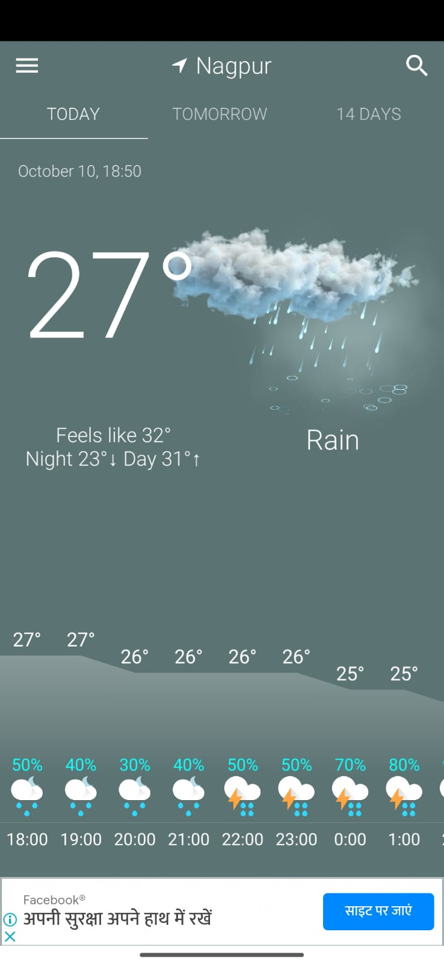
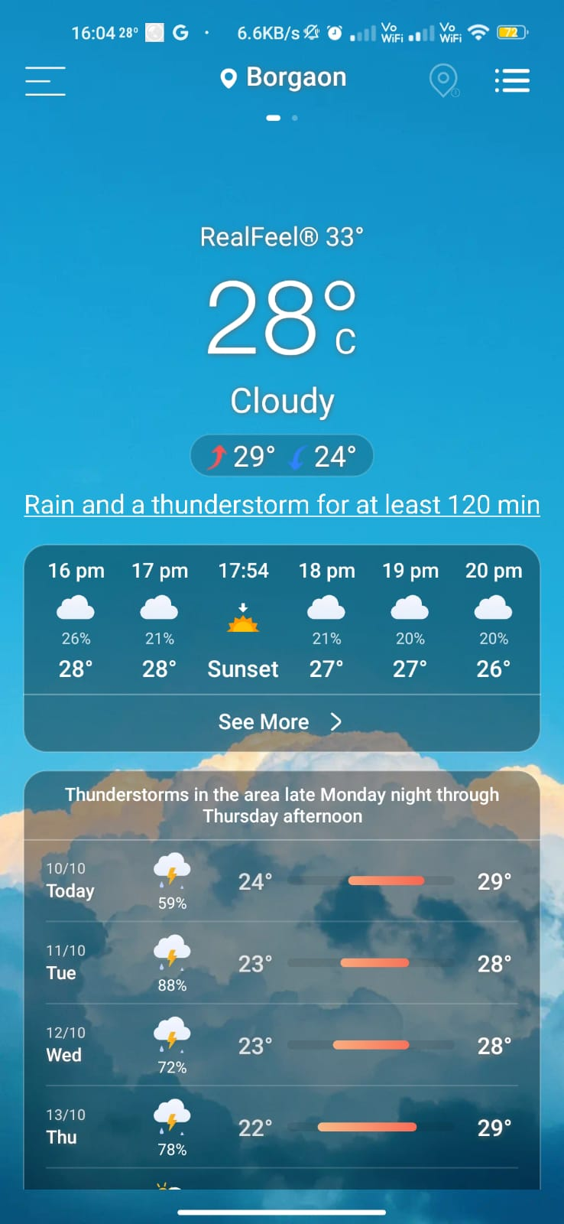
Literature Survey
1. Weather 1
2. Weather 1.1
S. B. Jain Institute of Technology Management and research
8

Slide 9
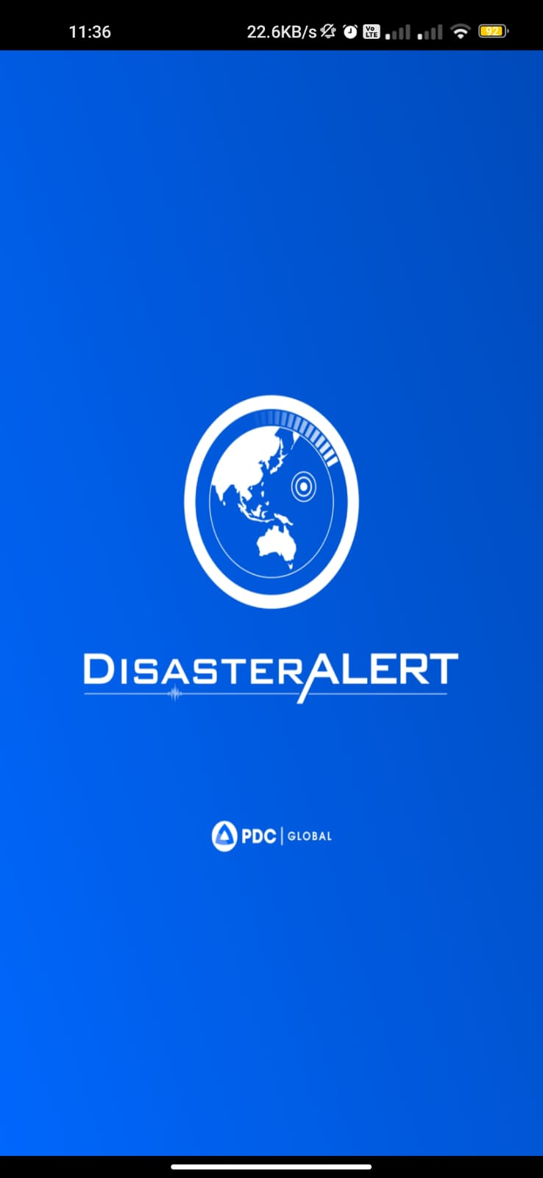
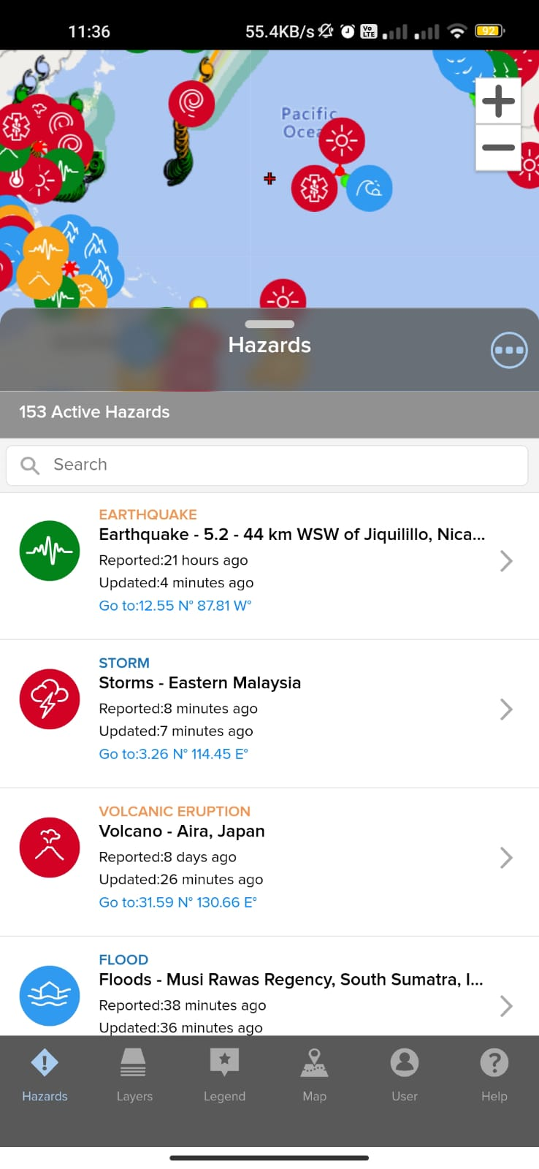
Literature Survey
3. Disaster Alert
S. B. Jain Institute of Technology Management and research
9

Slide 10
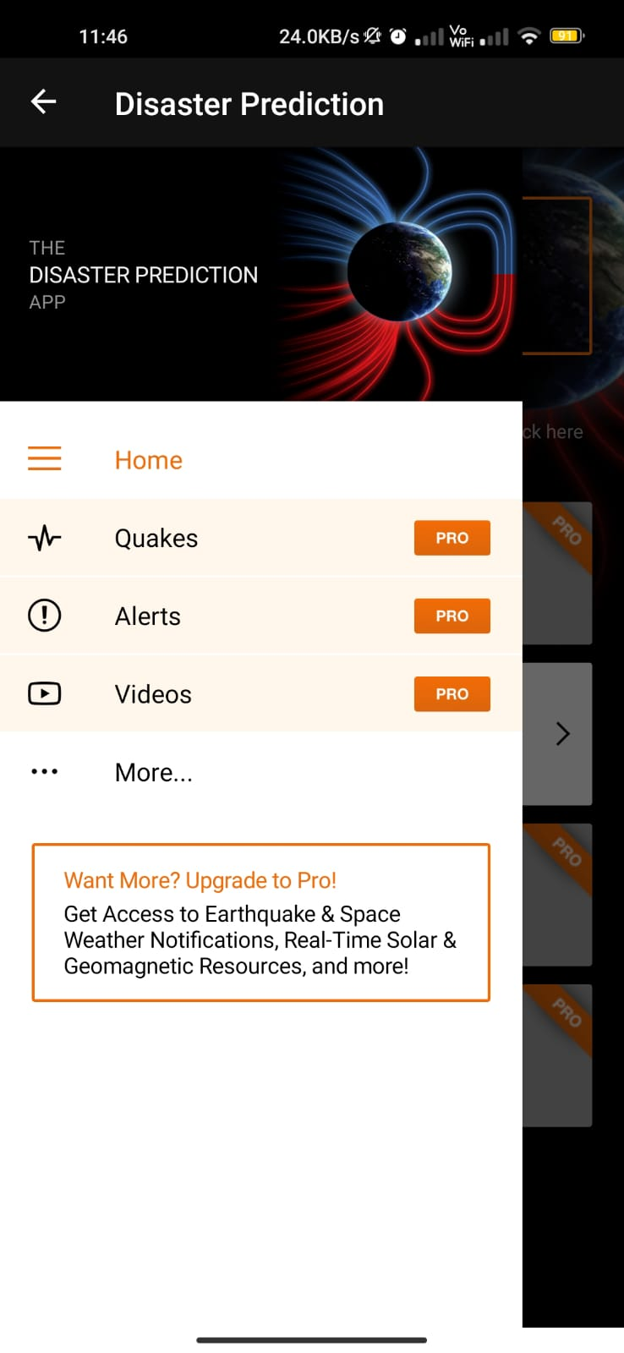
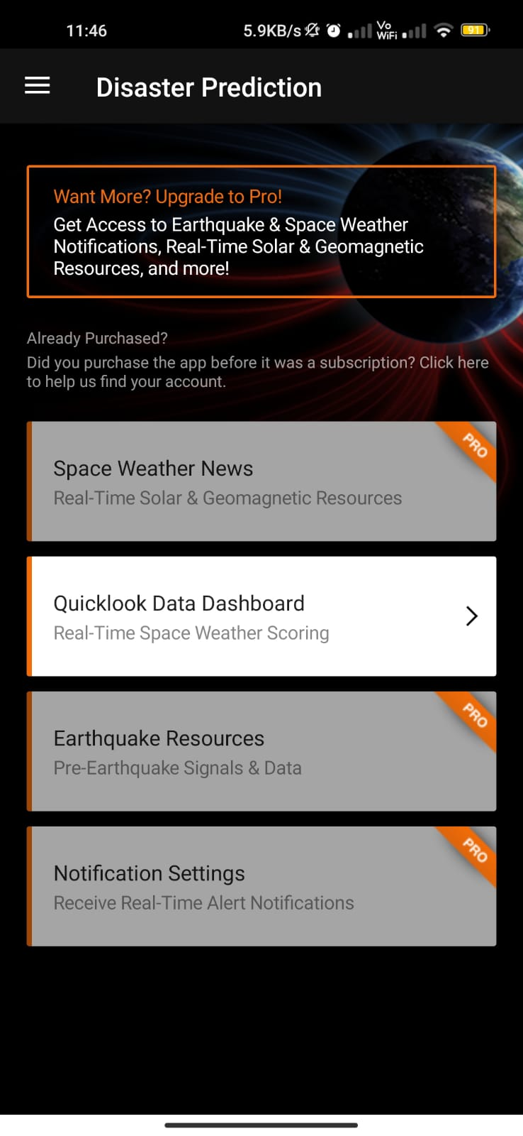
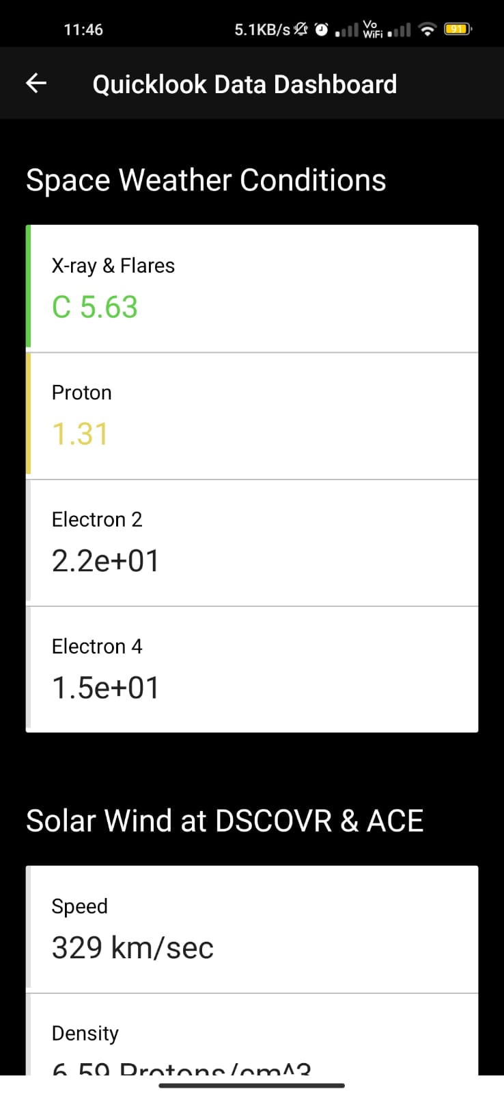
Literature Survey
4. Disaster Prediction
S. B. Jain Institute of Technology Management and research
10

Slide 11
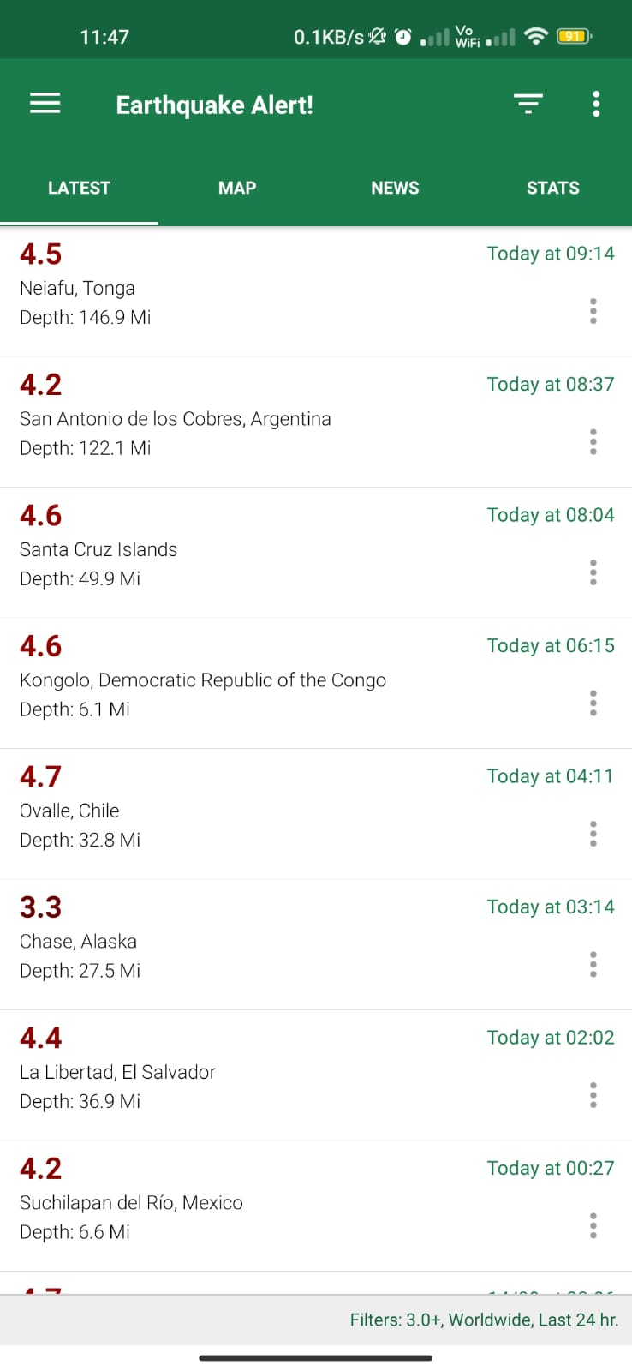
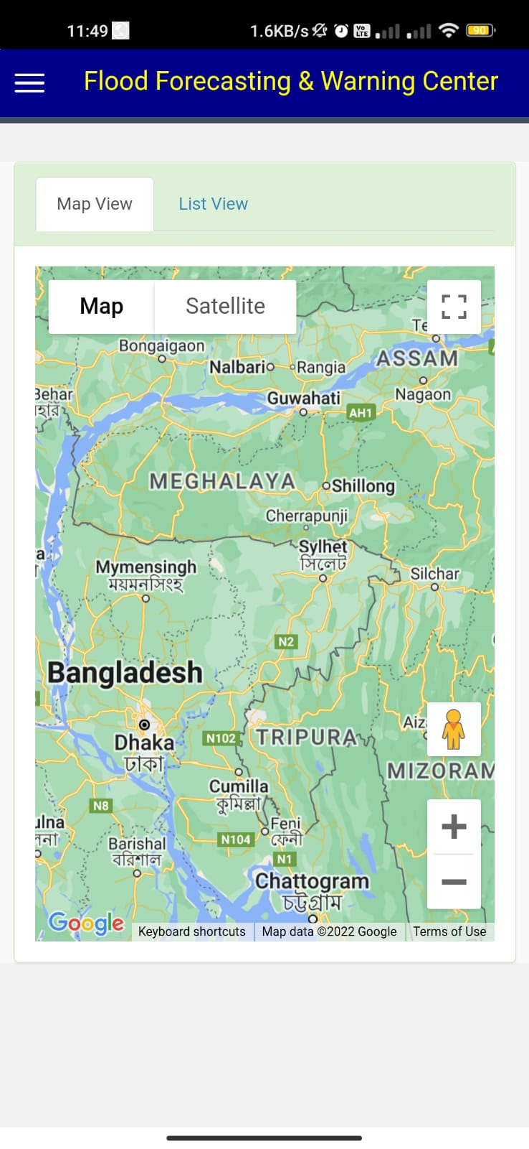
Literature Survey
5. Earthquake Alert
6. Flood Forecasting & Warning Center
S. B. Jain Institute of Technology Management and research
11

Slide 12
Proposed Work
The main purpose of this project is to provide users the real time Weather Forecasting based on the area and in addition to this, it will also let users see the future predictions for any kind of disasters along with a graph of past year’s data.
In our project there will be two modules :
Weather Forecasting
Disaster Predictions
S. B. Jain Institute of Technology Management and Research
12

Slide 13
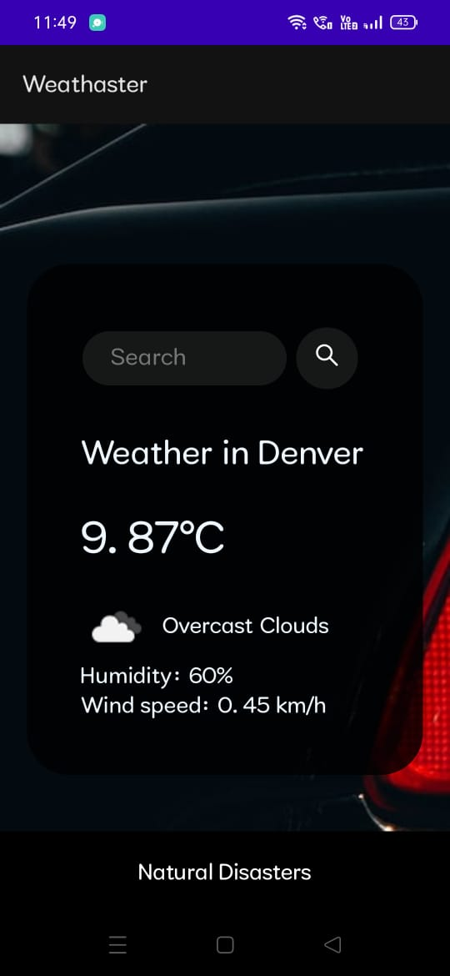
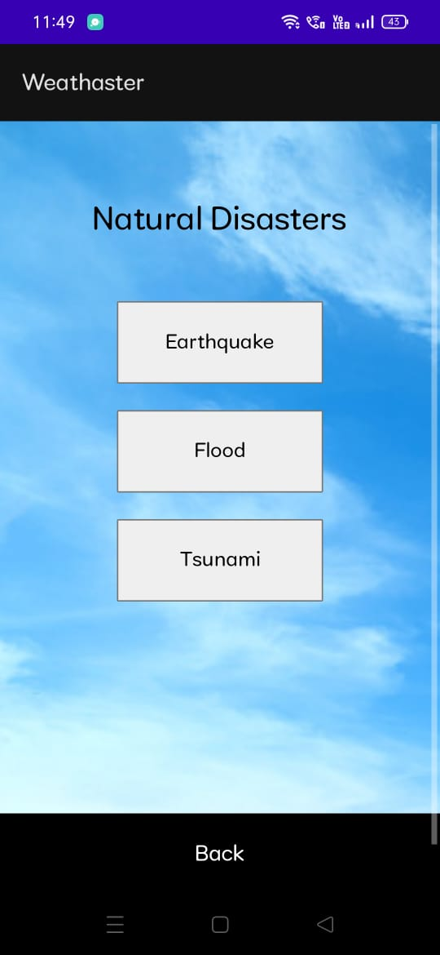
Screenshots

Slide 14
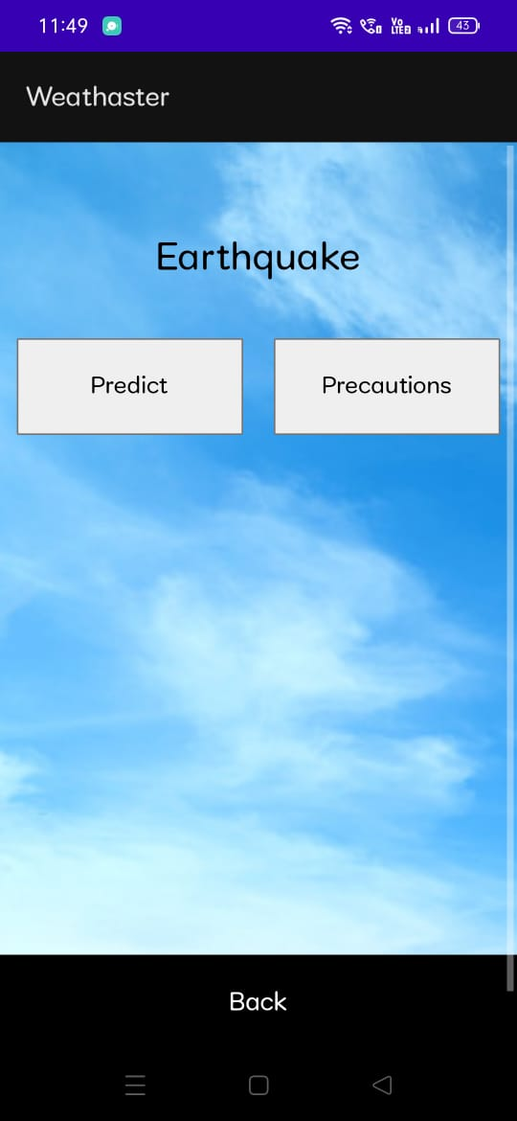
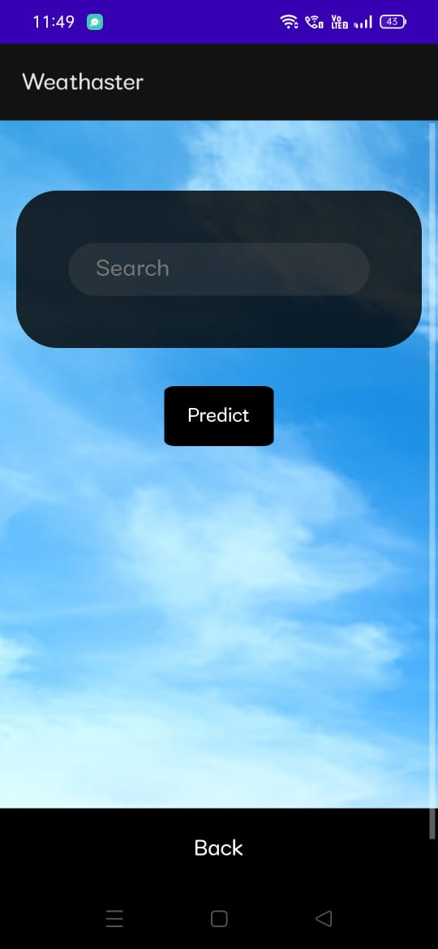
Screenshots

Slide 15
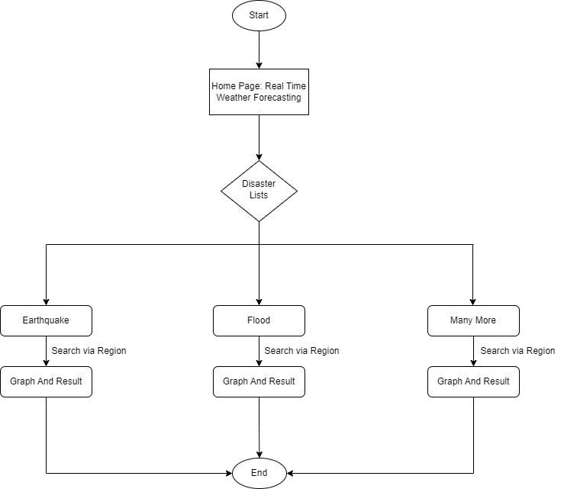
System Design: Flowchart
S. B. Jain Institute of Technology Management and research
15

Slide 16
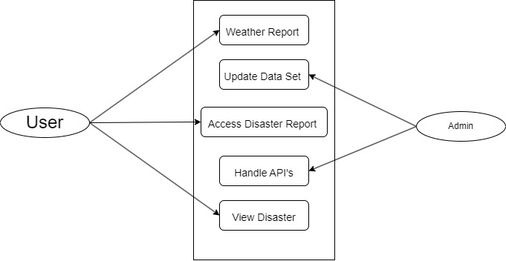
Use Case Diagram

Slide 17
Technology to be used
This Project can be implemented by using various technologies like-
1. Front End:
a. Html
b. CSS
c. Java Script
2. Back End:
Py-script & Datasets
S. B. Jain Institute of Technology Management and research
17

Slide 18
Advantages & Application
Advantages:
It is free to use.
User friendly.
Accurate in forecasting and predictions.
Application:
It will forecast real time weather.
It will be predicting the chances of any kind disasters in future.
S. B. Jain Institute of Technology Management and Research
18

Slide 19
Plan of Work
Work | Time (Days) | Status
Requirement Gathering (Project) | 2 days | Done
Analysis (Project) | 2 Day | Done
Requirement gathering & Analysis (Module1) | 5 days | Done
Implementation (Module1) | 6 days | Done
Testing (Module1) | 5 days | Done
Requirement gathering & Analysis(Module2) | 2 days | In progress
Implementation (Module2) | 4 days | Remaining
Testing (Module2) | 5 days | Remaining
Report Generation &Submission | 1 week | After Successful completion of above modules
Requirement gathering & Analysis(Module3) | - | -
Implementation (Module3) | - | -
Testing (Module3) | - | -
Report Generation &Submission | 1 week | After Successful completion of above modules
S. B. Jain Institute of Technology Management and Research
19

Slide 20
References
Papers:
1) A. Brighente, F. Formaggio, G. M. Di Nunzio, and S. Tomasin,“Machine learning for in-region location verification in wireless networks,” IEEE Journal on Selected Areas in Communications,
vol. 37, no. 11, pp. 2490–2502, 2019.
2) J. H. Samuel Lalmuanawma and L. Chhakchhuak, “Applications of machine learning and artificial intelligence for covid-19 (sars-cov-2) pandemic: A review,” Chaos, Solitons Fractals, vol. 139, p. 110059, 2020.
Website :
https://www.ualberta.ca/science/news/2020/march/machine-learning-disaster-prediction.html#:~:text=The%20scientists%20are%20using%20machine,as%20a%20landslide%20or%20earthquake
S. B. Jain Institute of Technology Management and Research
20

Slide 21
Thank You

